Slide 1
Comp 4350 Software Engineering II Lecture 7
Dr. Shaowei Wang

Slide 2
Agenda
What is AIOps
Motivating example
Sub-areas of AIOps research

Slide 3
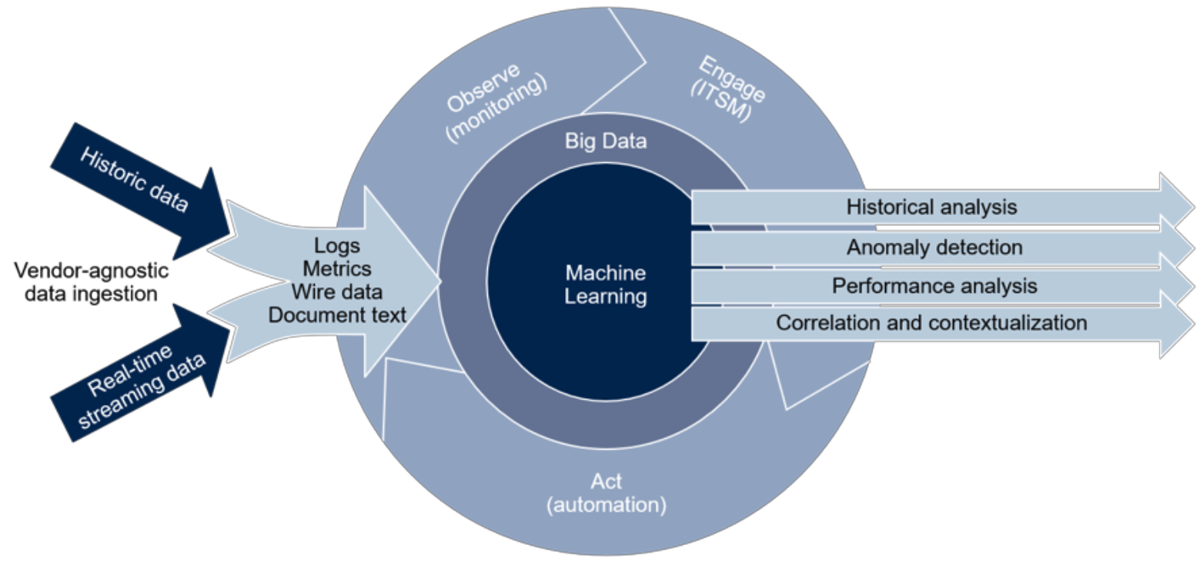
AIOps (Artificial Intelligence for IT Operations)
AIOps enhances IT operations (deployment and monitor) through greater insights by combining big data, machine learning and visualization
AIOps addresses the DevOps challenges with AI
From: 2018 Gartner
Notes:
Wire data: All data travels on the network, from user behavior to malware. Wire data is the result of continuously reassembling all those gigabytes of data into full transactions, flows, and sessions—the only way to see and analyze everything communicating on your network in real time.
ITSM: Information Technology Service Management is the activities that are performed by an organization to design, plan, deliver, operate and control information technology services offered to customers.

Slide 4
Monitoring is critical for ensuring the quality of the delivered services
code
deploy
plan
Dev
release
Ops
build
operate
test
monitor
Notes:
Software monitoring is an important component of the DevOps lifecycle.
During the DevOps lifecycle, engineers monitor the software systems to understand their state and runtime behavior, using techniques such as logging, tracing, and performance monitoring.

Slide 5
Monitoring is critical for ensuring the quality of the delivered services
code
deploy
plan
Logs
Metrics
Traces
Dev
release
Ops
build
operate
test
monitor
Notes:
Software monitoring produces large volumes of monitoring data, including logs, metrics, and traces.
By capturing and analyzing the monitoring data, engineers understand how changes or updates impact users, obtain clues about the root causes of runtime problems, and find evidences of unexpected runtime behaviors.
https://aws.amazon.com/devops/what-is-devops/
Active monitoring becomes increasingly important as software release cycles become shorter. For example, Facebook is released every few hours.

Slide 6
Increasing volume and complexity of monitoring data
Production Environments
Human Brain
The analysis and utilization of the big and complex monitoring data poses challenges to software monitoring..
Billions of logs, metrics, and alerts per day
Hundreds/thousands of events
Notes:
In addition, software monitoring produces large-volume and complex monitoring data.
For example, large-scale software systems can produce billions of logs, metrics, and alters per day.
In comparison, the human brain only has a short-term (~10-15 seconds) memory of 7 to 9 items. Humans could deal with hundreds/thousands of events.
%We’ve now reached a point in time where even the smartest humans can no longer cope with the volume of events in their environments.
The analysis and utilization of the big and complex monitoring data poses another challenge to software monitoring.

Slide 7
What is AI?
The simulation of human intelligence processes by machines, especially computer systems. These processes include learning, reasoning, and self-correction.
Knowledge-based approach to AI: hard coded knowledge using logical inference rules (e.g., autopilot systems)
Machine learning-based approach to AI: automatically learned rules from data (e.g., AlphaGo)

Slide 8
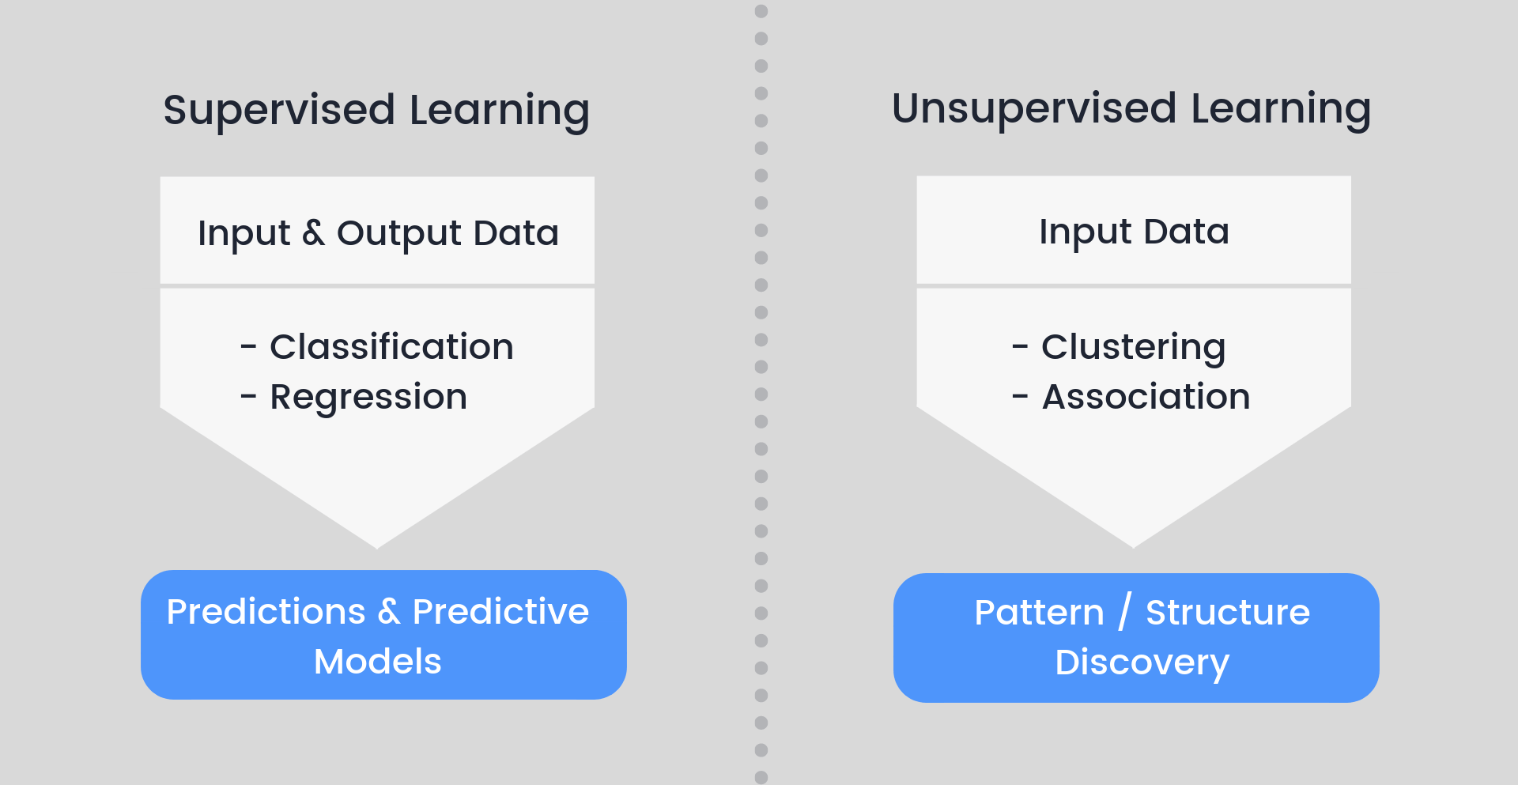
Common machine learning techniques
Semi-supervised
A small amount of labeled data with a large amount of unlabeled data.
Notes:
Semi-supervised learning is a class of machine learning tasks and techniques that also make use of unlabeled data for training – typically a small amount of labeled data with a large amount of unlabeled data.

Slide 9

Classification (categorical)
Notes:
Given a picture, tell if it is a car or dog?

Slide 10
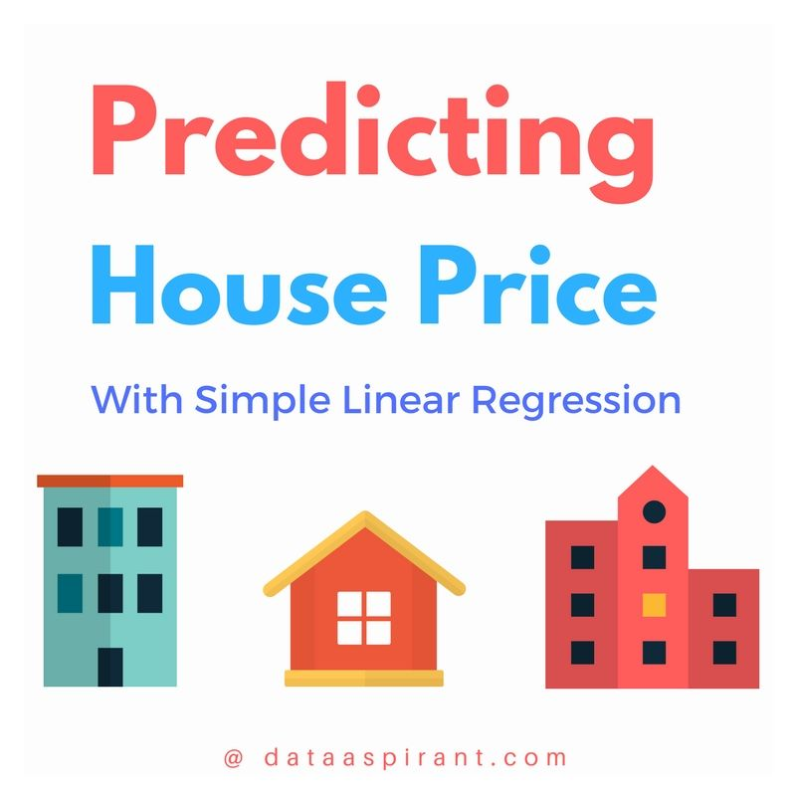
Regression (numeric)
Notes:
You have a couple of features (location, size, #bedroom, age ) of a house, predict its price

Slide 11
Frequent pattern (itemset) mining
Goal: finding sets of items frequently occurring together

Slide 12
Definition: Frequent Itemsets
Itemset: a set of items
E.g., acm={a, c, m}
(absolute) Support of itemsets
Sup(acm)=3
Given min_sup = 3, acm is a frequent pattern
Frequent pattern mining: find all frequent patterns in a database
Transaction database
TID | Items bought
100 | f, a, c, d, g, I, m, p
200 | a, b, c, f, l, m, o
300 | b, f, h, j, o
400 | b, c, k, s, p
500 | a, f, c, e, l, p, m, n
12
Notes:
12

Slide 13
Clustering: the process of grouping a set of objects into classes of similar objects

Slide 14
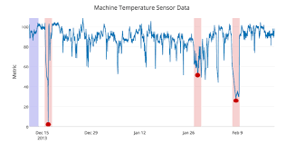

Anomaly detection
Anomaly detection (aka outlier analysis) is a step in data mining that identifies data points, events, and/or observations that deviate from a dataset's normal behavior.

Slide 15
Beyond Ops: Making monitoring code right
Monitoring code
Monitoring data
Monitoring code made right
Monitoring data used right

Slide 16
Motivating Example
Autonomous configuration of large-scale software systems

Slide 17



Manually configuring large-scale software systems is costly & error-prone
Configuration
Unsatisfied perf. ?
Workload
Software system
Performance
Workloads are constantly evolving, requiring constant human intervention to ensure optimal performance
Notes:
Workloads constantly changes, for example, the workload may get peaked during holiday season, black Friday, boxing day. While get relative light during other seasons. Need to increase the servers during busy time and reduce during idle time. Requiring constant human intervention to ensure optimal performance while saving resources.
For db system, at initial stage, we may use the default setting, as time going on, and more inquiries we get, we can optimize the configuration (adjust cache size, creating index, change size of connection pool) of db to optimize the performance of db.

Slide 18
Parameters of Database system
Cache.size
Some performance improvement may be seen by increasing the size of the cache, which reduces I/O. For best results, the cache size should be a prime number. Increasing the size may give improved performance at the expense of memory usage.
Fetch.blocksize
By knowing the number of rows of data you need to retrieve or fetch from the database, you can configure this parameter, using PointBase Server only, to minimize network traffic and improve performance. This can also be set via a JDBC statement for individual statements.
Table.pageReserve
By configuring this parameter you can reserve space in each table to improve the performance of the system every time it performs an UPDATE. This parameter specifies how much space should be reserved while inserting rows into a table. If the table is not updated, then you can set this value to 0.
…
Notes:
Why cache size set to prime number?
https://stackoverflow.com/questions/43140040/why-are-cache-sizes-often-defined-as-prime-numbers
https://safari.ethz.ch/architecture/fall2017/lib/exe/fetch.php?media=kharbutli_hpca2004.pdf

Slide 19
Characteristics of Workload
Number of user requests
Query type (insert, fetch)
Size of each fetch
Frequency of queries on each table
…

Slide 20
Optimization goal
Minimize the latency of queries on average
Use minimal memory

Slide 21


Using an AIOps solution to autonomously tune system configurations
Self-configuring
Optimized parameter values
Self-optimizing
Performance measures
Logs
Metrics
Self-monitoring
Software system
[Li et al. 2018]

Slide 22
Challenges in autonomous configuration of large-scale software systems
Complex system
behavior
Fast response to environment
Minimal footprint
[Li et al. 2018]

Slide 23
Challenges in autonomous configuration of large-scale software systems
Complex system
behavior
Fast response to environment
Minimal footprint
[Li et al. 2018]
Notes:
Understand how the hundreds of parameters can impact the performance of the system.

Slide 24
Challenges in autonomous configuration of large-scale software systems
Complex system
behavior
Fast response to environment
Minimal footprint
[Li et al. 2018]
Notes:
Understand how the hundreds of parameters can impact the performance of the system.

Slide 25
Understanding the relationship between config. parameters and performance metrics
Perf. related parameters
Perf. data
Impact of parameters?
Asking domain experts
Running tests
[Li et al. 2018]
Notes:
In order to understand how the configuration parameters impact the runtime performance of the system, we first discussed with senior developers about which parameters might impact the system performance, and how developers typically set the parameter values during their own testing. We then ran testing experiments with different parameter configurations to understand runtime system behaviour and how different configurations actively impact the performance of the system. The senior developers’ advice and our exploratory experiments provided us a rough idea about the configuration parameters’ impact on the system performance.

Slide 26
Blue force approach
One way to fully understand the effect of the configuration parameters on system performance is to exhaustively run different combinations of the parameter values.
However, too many combination to test
5 parameters, and each parameter has 10 settings, we have 10^5 combination!
Infeasible! Each combination requires several hours to run.
What if coming with hundreds of parameters?

Slide 27
Understanding the relationship between config. parameters and performance metrics
Perf. critical parameters
Perf. related parameters
Perf. data
Asking domain experts
Running tests
Multivariate Adaptive Regression
Splines (MARS)
Only a few out of many candidate parameters significantly impact system performance and reduce the search space.
[Li et al. 2018]
Notes:
we performed a sensitivity analysis to understand the configuration parameters’ impact on the system performance. Specifically, we built Multivariate Adaptive Regression Splines (MARS) [6] models to understand the relationship between the parameters and the performance measures. The significant parameters will be selected and will be tuned.

Slide 28
Challenges in autonomous configuration of large-scale software systems
Complex system
behavior
Fast response to environment
Minimal footprint
[Li et al. 2018]
Notes:
How to response to the environment as fast as possible. We need fast algorithm to give optimial solution for the current environment.

Slide 29
Real-time monitoring of system behavior using readily-existing logs and metrics data
Logs
Metrics
Log & metric streams
Original system
Real-time perf. measures
Perf. opt.
[Li et al. 2018]

Slide 30
How to capture KPI for different setting of parameters
Simulating the behavior of different setting of parameters and record them
Slow but accurate
Historical data
E.g., pairs <parameters, KPIs>
Fast but not very accurate

Slide 31
Machine learning-based
As time going, we will get more and more data!
Such data could be used to training machine learning models to auto-tune the parameters.
Pairs <characteristics of current workload, settings of parameter>

Slide 32
Challenges in autonomous configuration of large-scale software systems
Complex system
behavior
Fast response to environment
Minimal footprint
[Li et al. 2018]
Notes:
Minizie the change of exiting system and the overhead of the system

Slide 33
Minimize the change of exiting system and the overhead of the system
Adding new features to an existing needs to perform significant code changes and may affect the overall design of the system, which may cause additional bugs, development overheads, and maintenance problems.

Slide 34
Separating the autonomous configuration capabilities from the original system
Self-configuring
Optimized parameter values
Self-optimizing
Remote control
Performance measures
Logs
Metrics
Self-monitoring
Software system
[Li et al. 2018]
Notes:
Self-monitoring: to minimize performance impact and the required code changes when monitoring the system, we leverage existing system logs (e.g., web server access logs) and collect performance counters (e.g., sampled CPU and memory usage).

Slide 35
Autonomous configuration significantly improves system performance
Low workload, KPI is optimal
High workload, KPI drops
Autonomous configuration
(KPI)
[Li et al. 2018]
Notes:
KPI, for example, Request time for user request

Slide 36
Autonomous configuration significantly improves system performance
Adapting quickly to the changing workloads
KPI is always optimal
Autonomous configuration
(KPI)
[Li et al. 2018]
Notes:
Use 1 – KPI instead

Slide 37
Sub-areas of AIOps research

Slide 38
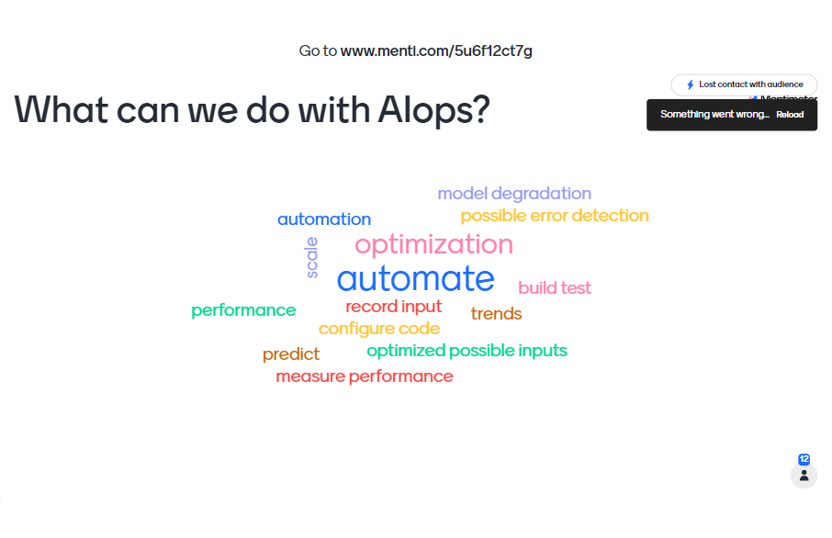

Slide 39
Generating & leveraging monitoring data
Monitoring code
Monitoring data
Generating Monitoring code right
Using Monitoring data right
Notes:
AIOps leverages big data and machine learning techniques to analyze and make sense of monitoring data.
The sub-areas of AIOps research include research on how to efficiently generate monitoring data and how to effectively leverage monitoring data.

Slide 40
Sub-topics of AIOps research
Autonomous configuration
Log abstraction
Fault diagnostics
Automated logging
Anomaly detection
Logging practices
Performance analysis
Software System
AIOps infrastructures
System comprehension
Incident prediction
Generating Monitoring code right
Using Monitoring data right

Slide 41
Sub-topics of AIOps research
Autonomous configuration
Log abstraction
Fault diagnostics
Automated logging
Anomaly detection
Logging practices
Performance analysis
Software System
AIOps infrastructures
System comprehension
Incident prediction
Generating Monitoring code right
Using Monitoring data right

Slide 42

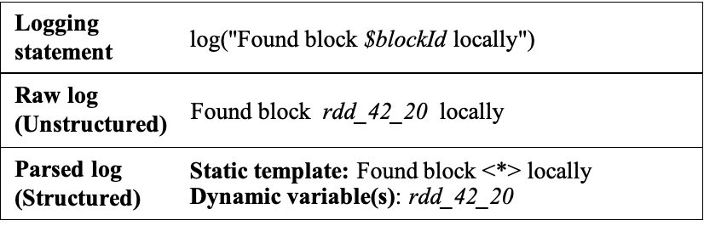
Log parsing is the first step for many log analysis tasks
System comprehension
Anomaly detection
Fault diagnostics
Parsing is the process of splitting unstructured log data into structured data format.

Slide 43
Log parsing is the first step for many log analysis tasks
System comprehension
Anomaly detection
Fault diagnostics

Slide 44
Why we need this? Reduce the size
User checkout for accountID(Tom), item=100
User checkout for accountID(Jenny), item=100
Item shipped for accountID(Tom), item=100
User checkout for accountID(John), item=100
Events | Lines
User checkout for accountID($v), item=$v | 1, 2, 4
Item shipped for accountID($v), item=$v | 3
[Jiang et al. 08]
Notes:
The large volume of logs, produced by enterprise applications, limits the usefulness of manual analysis techniques.
Automated log analysis face challenges to deal with the unstructured logs.
Automated techniques are needed to uncover the structure of execution logs. Using the uncovered structure, sophisticated analysis of logs can be performed.

Slide 45
How many types of “errors” are there? – prioritize work based on frequency
One enterprise application from BlackBerry generates 1.6 million log lines (in 8 hours) and 23,000 lines contain “fail” or “failure”
Total 319 execution events, among them 16 contains “fail” or “failure”
Events | Frequency
Error occurred during purchasing, item=$v | 500
Error! Cannot retrieve catalogs for user=$v | 300
Authentication error for user=$v | 100
[Jiang et al. 08]
Notes:
Using the frequency of failure events, the developer can prioritize his work by tackling the most frequently occurring failures first.

Slide 46
Sub-topics of AIOps research
Autonomous configuration
Log abstraction
Fault diagnostics
Automated logging
Anomaly detection
Logging practices
Performance analysis
Software System
AIOps infrastructures
System comprehension
Incident prediction
Generating Monitoring code right
Using Monitoring data right
Notes:
Identify the root leading to the performance issues and its location

Slide 47
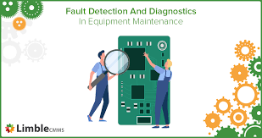
Fault diagnostics
Identify the root leading to the fault and its location

Slide 48
Performance Debugging in the Large via Mining Millions of Stack Traces - Microsoft
Performance bugs leads to unbearably slow system
To debug performance issues, Windows has the facility to collect millions of execution traces (data is available)
Call stack - … InitComponents, GetHashCode, GetShortPathName, MmAccessFault …
Which calls slow down the system?
https://www.researchgate.net/publication/241632979_Performance_debugging_in_the_large_via_mining_millions_of_stack_traces
Notes:
Stack traces

Slide 49
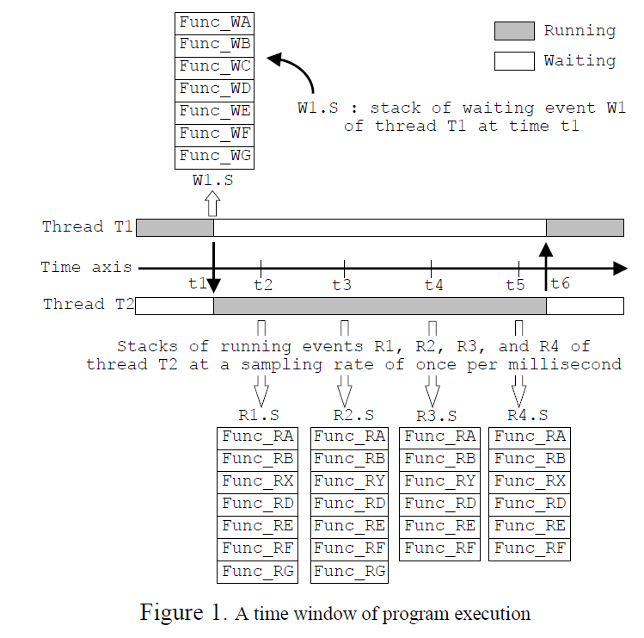
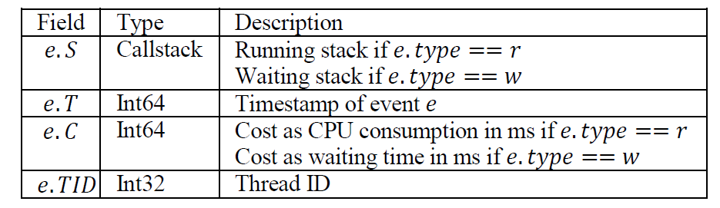
How to form it as a pattern mining problem?
Transaction data
Callstack
pattern
If a callstack pattern is observed from many trace streams that cost large amount of CPU, it is suspicious to be a highly impactful performance bug
Notes:
They modify the definition of support to include cost of event info, but it still follow the aprior property.

Slide 50
Using clustering to reduce the size
Proposed solution:
Group related execution trace patterns together to enable performance debugging in large scale
Select the representative pattern from each cluster to investigate

Slide 51
Using clustering to reduce the size
Proposed solution:
Group related execution trace patterns together to enable performance debugging in large scale
Select the representative pattern from each cluster to investigate

Slide 52
Methodology
Phase 1: Extract area of interest
Focus on events
CPU consumption (if running)
Waiting time (if waiting)
Use developer's domain knowledge to localize this area of interest (e.g., the waiting time > threshold)
Phase 2: Extract frequent sequential patterns
Phase 3: Cluster the patterns together (why? They want to consider slightly different patterns)
Notes:
Not all collected execution traces are interesting

Slide 53
Methodology
Hierarchical clustering is performed
Key: similarity measure
Similarity measure:
Alignment of two patterns
Computation of similarity
Notes:
Similar to computing edit distance given two strings.

Slide 54
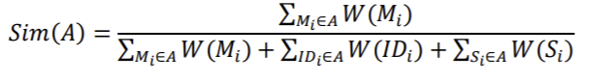
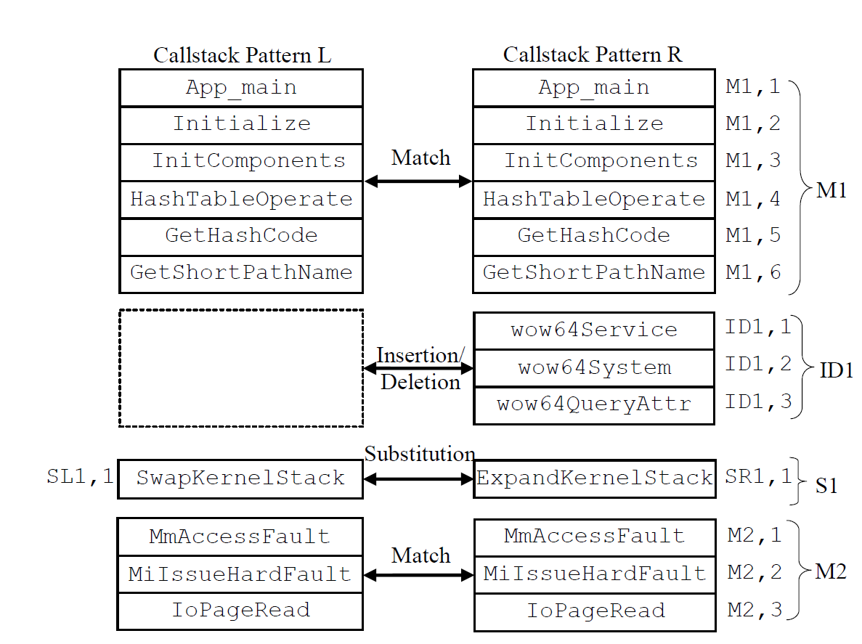
Define cost of alignment (edit cost) and get optimal alignment.
Notes:
Similarity = portion of match/ all components. More match , larger Numerator, more dismatch, larger denominator

Slide 55
Experiment
Finding hidden performance bugs on Windows Explorer UI
Input: 921 trace streams (A trace stream records a stream of system level events to capture the program execution behaviors during a time period of bad performance)
140 million call stacks
Output: 1,215 pattern clusters
Pattern mining and clustering time: 10 hours
Developer manually investigate the clusters (top-400)
Eight hours -> detect 12 highly impactful performance bugs
Notes:
A trace stream records a stream of system level events to capture the program execution behaviors during a time period of bad performance.

Slide 56
Sub-topics of AIOps research
Autonomous configuration
Log abstraction
Fault diagnostics
Automated logging
Anomaly detection
Logging practices
Performance analysis
Software System
AIOps infrastructures
System comprehension
Incident prediction
Generating Monitoring code right
Using Monitoring data right

Slide 57
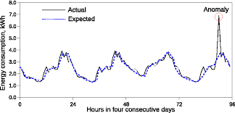
Anomaly detection
Anomaly detection (aka outlier analysis) is a step in data mining that identifies data points, events, and/or observations that deviate from a dataset's normal behavior.

Slide 58

Automated Functional Analysis
(E2, E3) are always together:
(acquire_lock, release_lock)
(open_inbox, close_inbox)
If we see (E2, E6) this might be a problem
E1
E2
E3
E4
E1
E2
E3
E4
E1
E2
E3
E4
E1
E2
E6
E4
[Jiang et al. 08]
Notes:
In your program, some methods are usually called in sequence.

Slide 59
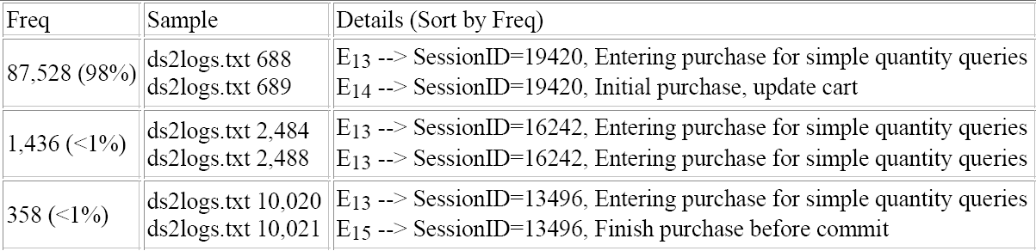



Case study on Dell DVD Store
99.99% reduction in viewed log lines
with a precision of 56-100%
[Jiang et al. 08]
Notes:
E13 usually follow up with E14, but in a small portion of cases E13 not follow up with E4, they check such cases and identify some bugs.
Two bugs
Malformed SQL queries due to pretty print numbers (e.g., 1000 for 1,000)
Random number collision for session ID (we check the users later)
Huge reduction for the data needs to be analyzed and high precisions.

Slide 60
Sub-topics of AIOps research
Autonomous configuration
Log abstraction
Fault diagnostics
Automated logging
Anomaly detection
Logging practices
Performance analysis
Software System
AIOps infrastructures
System comprehension
Incident prediction
Generating Monitoring code right
Using Monitoring data right
Notes:
Predict if an incident will happen in the future

Slide 61
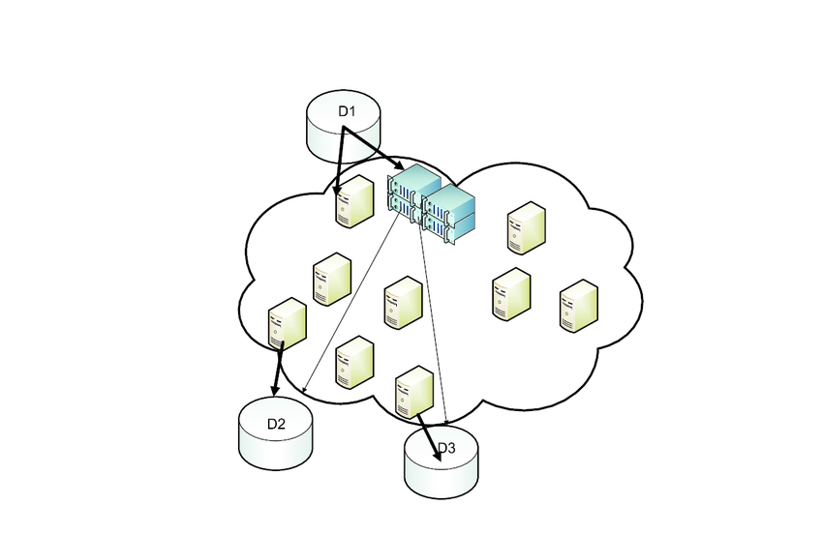

Prediction the failure nodes on cloud

Slide 62
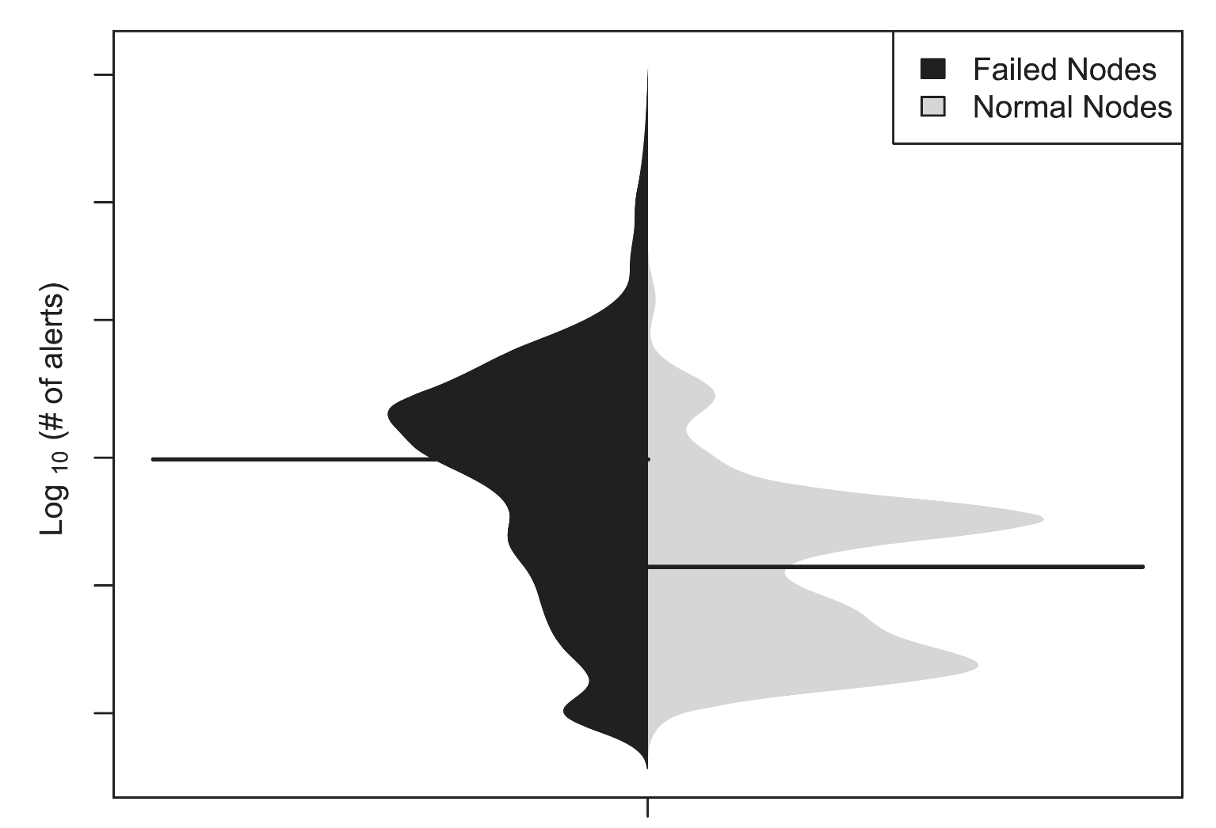
Early monitoring data shows different distributions between failed nodes and normal nodes in a large-scale cloud
The distributions of the alerts in failed vs. normal nodes
[Li et al. 19]

Slide 63
Predicting Node Failures in an Ultra-large-scale Cloud Computing Platform
[Li et al. 19]

Slide 64
Predicting Node Failures in an Ultra-large-scale Cloud Computing Platform
[Li et al. 19]

Slide 65
Predicting Node Failures in an Ultra-large-scale Cloud Computing Platform
[Li et al. 19]
AUC: 0.92

Slide 66
Exercise: select the AIOps solutions for given scenarios
Given the existing monitoring data of a large-scale software system, you want to determine whether there will be a runtime failure in the next two hours. Which type of AIOps solution will you use?
A. Fault diagnostics
B. Anomaly detection
C. Incident prediction
Notes:
C

Slide 67

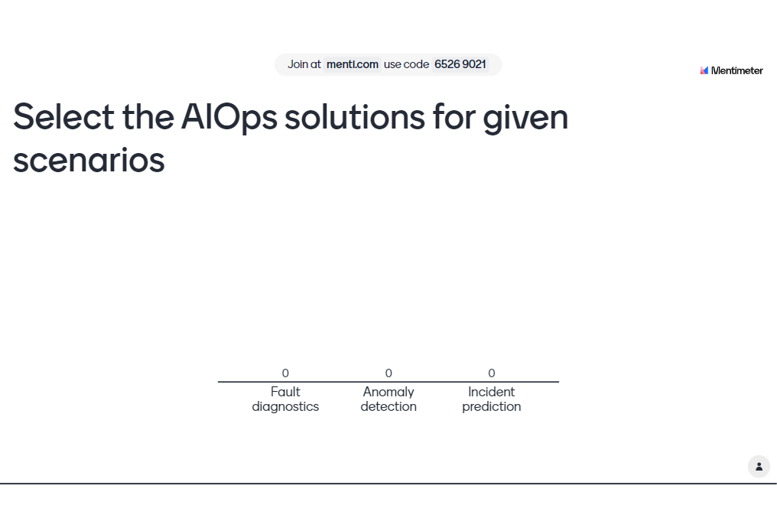

Slide 68
References
Automated logging: Li et al. Studying Software Logging Using Topic Models. [EMSE 2018]
Logging practices: Chen et al. Characterizing and Detecting Anti-patterns in the Logging Code. [ICSE 2017]
Autonomous configuration: Li et al. Adopting autonomic computing capabilities in existing large-scale systems: an industrial experience report. [ICSE-SEIP 2018]
Log abstraction: Jiang et al. An automated approach for abstracting execution logs to execution events. [JSME 2008]
Fault diagnostics: Syer et al. Leveraging performance counters and execution logs to diagnose memory-related performance issues. [ICSM 2013]
Anomaly detection: Jiang et al. Automatic identification of load testing problems. [ICSM 2008]
Performance analysis: Jiang et al. Automated Performance Analysis of Load Tests. [ICSM 2009]
Incident prediction: Li et al. Predicting Node Failures in an Ultra-large-scale in Cloud Computing Platform: an AIOps Solution. [TOSEM 2020]
System comprehension: Shang et al. Assisting Developers of Big Data Analytics Applications When Deploying on Hadoop Clouds. [ICSE 2013]
Tune system configurations: Lu et al. Speedup your analytics: Automatic parameter tuning for databases and big data systems. Proceedings of the VLDB Endowment. 2019 Aug 26.

Slide 69
Sub-topics of AIOps research
Autonomous configuration
Log abstraction
Fault diagnostics
Automated logging
Anomaly detection
Logging practices
Performance analysis
Software System
AIOps infrastructures
System comprehension
Incident prediction
Monitoring code made right
Monitoring data used right

Slide 70

Comparing system performance with a baseline derived from previous runs
Throughput | Performance Deviation | Event Sequences
5,000 5,002 | 0.8 | $$E1→E2→E3→E4$$
4,500 4,498 | 0.5 | $$E1→E3→E5→E7→E4$$
4,000 4,010 | 0.3 | $$E1→E3→E5→E7→E2→E4$$
[Jiang et al. 09]
Notes:
Red = Current test is slower
Blue = Current test is faster
Overview, sort by their likelyhood of bugs
Visualization has two parts
Distribution using bean-plots (like a flipped probably density plot (pdf))
Evolution showing response time over time (in case it degrades)
Once we get a sense of how different the response time from two tests are, we want to see what causes the differences.

Slide 71
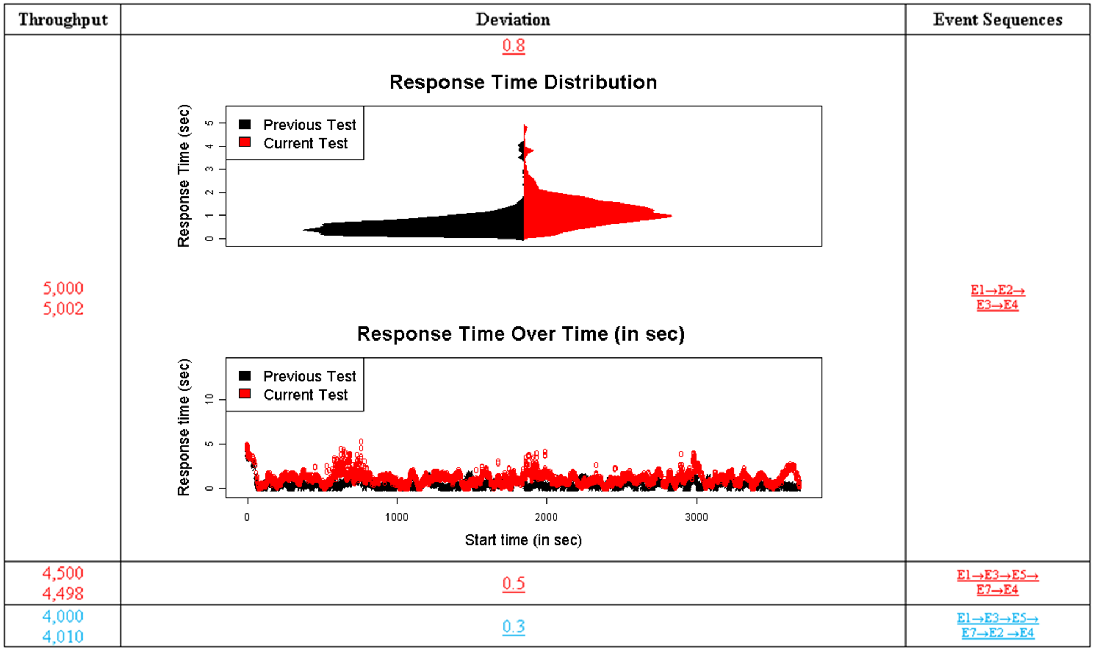
Performance Analysis Report - Visual Comparison
Distribution
Evolution
[Jiang et al. 09]
Notes:
Red = Current test is slower
Blue = Current test is faster
Overview, sort by their likelyhood of bugs
Visualization has two parts
Distribution using bean-plots (like a flipped probably density plot (pdf))
Evolution showing response time over time (in case it degrades)
Once we get a sense of how different the response time from two tests are, we want to see what causes the differences.

Slide 72
Comparing system performance with a baseline derived from previous runs
Throughput | Performance Deviation | Event Sequences
5,000 5,002 | 0.8 | $$E1→E2→E3→E4$$
4,500 4,498 | 0.5 | $$E1→E3→E5→E7→E4$$
4,000 4,010 | 0.3 | $$E1→E3→E5→E7→E2→E4$$
[Jiang et al. 09]
Notes:
Red = Current test is slower
Blue = Current test is faster
Overview, sort by their likelyhood of bugs
Visualization has two parts
Distribution using bean-plots (like a flipped probably density plot (pdf))
Evolution showing response time over time (in case it degrades)
Once we get a sense of how different the response time from two tests are, we want to see what causes the differences.

Slide 73
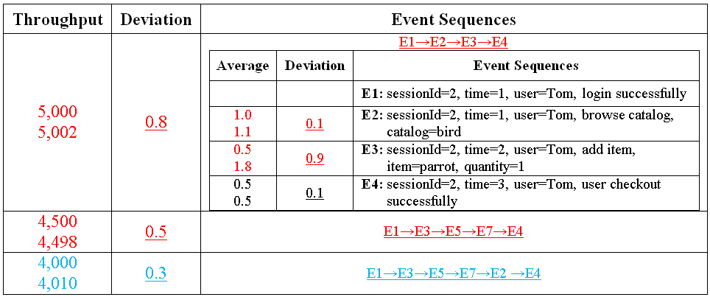
Performance Analysis Report - Step-wise Performance Diagnosis
77% precision (low false positive rate)
[Jiang et al. 09]

Slide 74

When you observe a system, you are perturbing it. No free lunch
Observer effect
Eg measuring the tire pressure lets out some of the air
Observer effect applies to the monitoring of software systems
Eg performance overhead
Notes:
However, monitoring is not free!
In physics, there is an Observer effect. When you observe something, you are changing its behavior or characteristics.
…
The monitoring overhead poses a challenge to software monitoring.

